Slide 1
Welcome to Christ Church Primary School
New Parents’ Meeting
June 27th 2023

Slide 2
Foundation Stage
What is the Foundation Stage?
The Foundation Stage is the stage of education for children from birth up to the end of the Reception year.
The Foundation Stage Curriculum is based on the recognition that children learn best through play and active learning.
The reception year is the final year of the Foundation Stage

Slide 3
The Curriculum
Communication and Language
Personal, Social and Emotional Development
Physical Development
Literacy
Mathematics
Understanding the World
Expressive Arts and Design

Slide 4
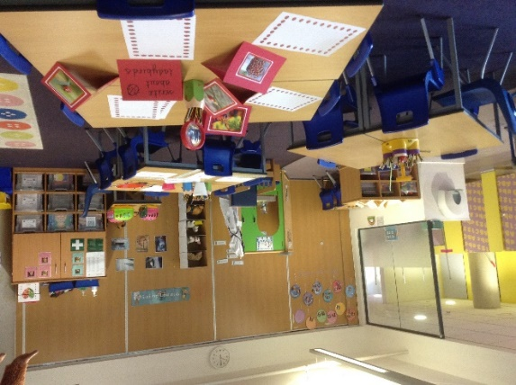
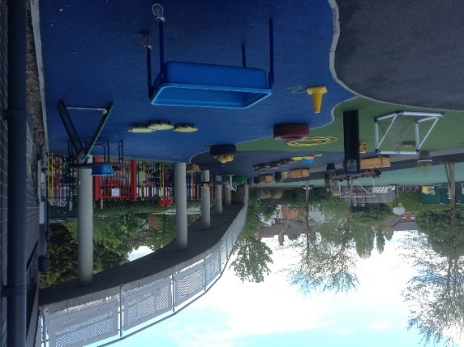
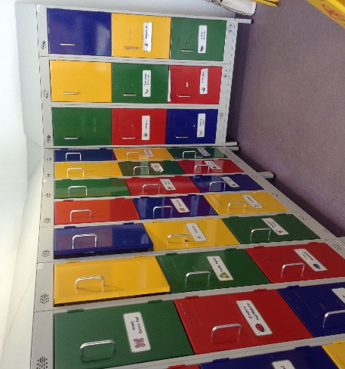
Our Reception Classrooms
The children are organised into two classes with 23 children in each.
We have toilets within the classroom space and children are able to use them as required.
The children have a locker to keep their coats and other belongings.
The outside space is used daily (weather permitting) and supports the learning that is taking place indoors.

Slide 5
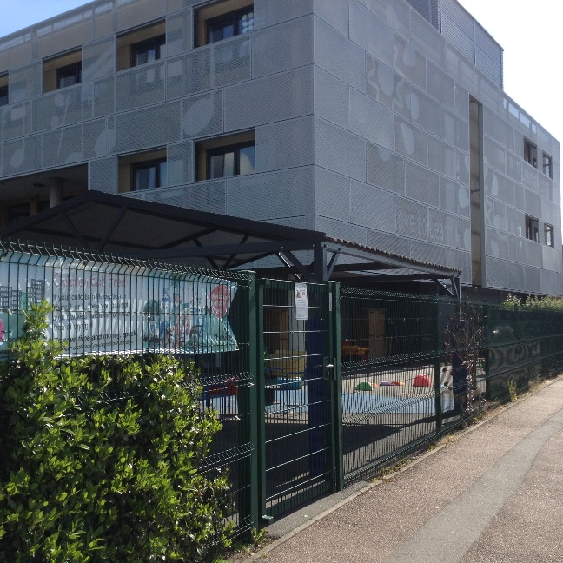
Arriving at school and Home- time Collection
Reception children enter and leave our school site through the side gate on Dale Street.
Arrival times are staggered with other year groups to ease congestion.
Arrival time for reception children is 8.45 am.
Collection time for reception children is 3.10pm.
Please inform us if a different person will be collecting your child.

Slide 6
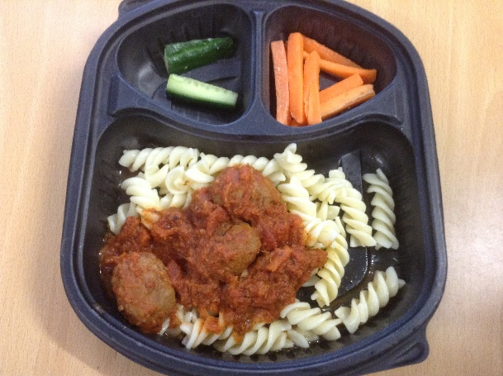
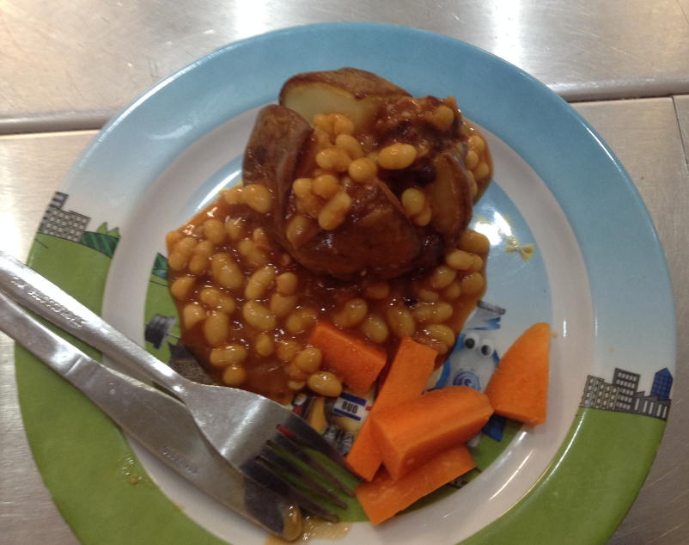
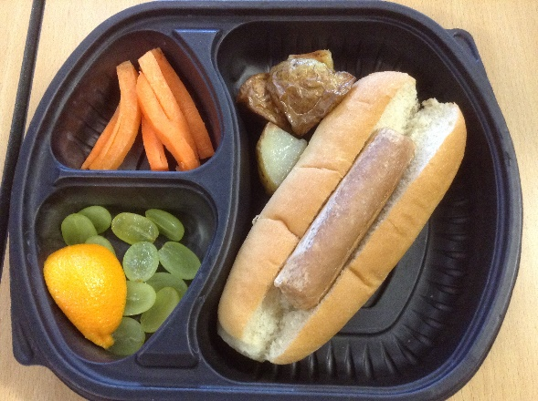
Snacks & Lunch time
During the morning session, your child will be provided with a fruit or vegetable snack and a drink of milk or water.
In reception and KS1, all lunches are provided for free. You will receive a menu so that you can discuss the choices available with your child.
Your child will make a choice each day and tell their teacher at register time.
They can choose from different options and vegetarian choices are available daily.

Slide 7
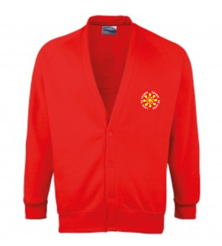
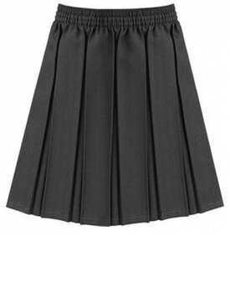
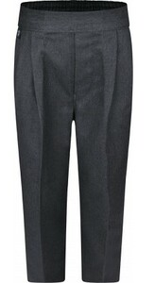
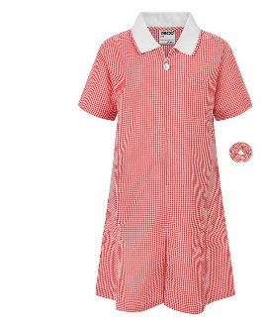
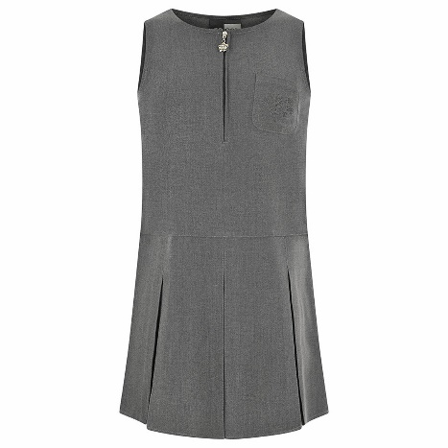
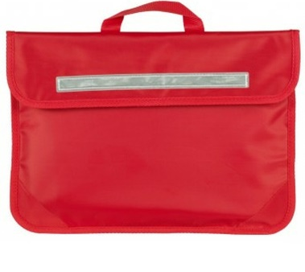
Uniform
Our uniform comprises of:
A red jumper or cardigan
A white shirt, blouse or polo - shirt
Grey trousers, skirt or pinafore
Red gingham dresses may be worn in summer
Black, grey or white socks or grey tights
Black shoes (no trainers)
A book bag
A water bottle
ALL UNIFORM SHOULD BE NAMED

Slide 8
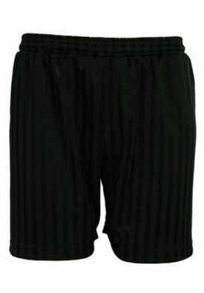
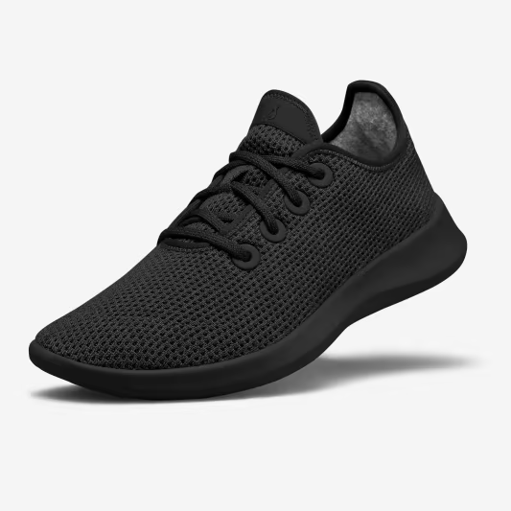
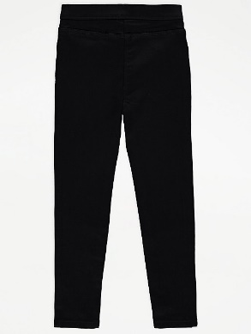
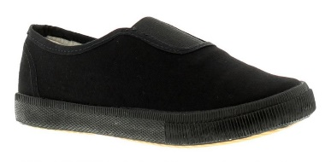
PE Kit
Our PE kit comprises of:
A plain white T-shirt
Plain black shorts or leggings
Black pumps or black trainers
Pupils will come to school wearing kit on their PE day. Staff will notify you when PE sessions begin.

Slide 9
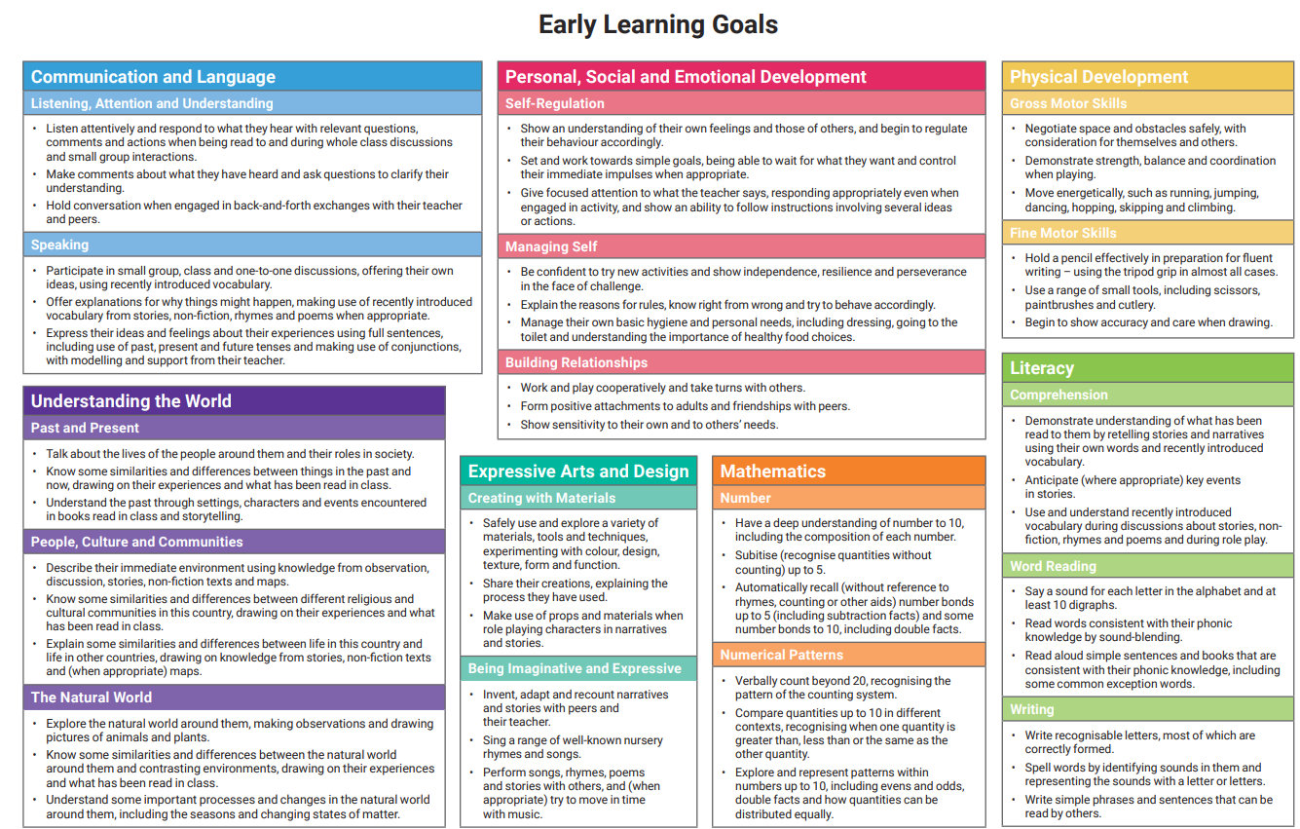
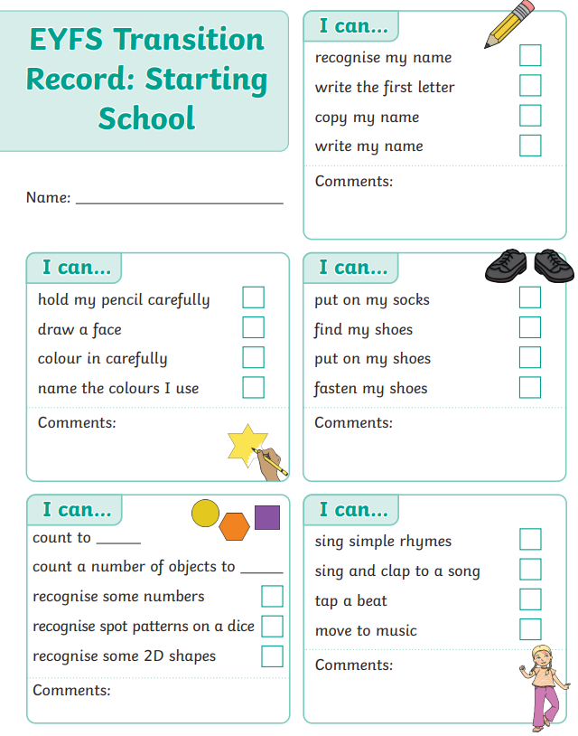
In your pack
In your pack you will find:
A pack of forms. These should be returned to the office Next week on transition day or by July 13th at very latest. Please can you bring your child’s birth certificate with you
School readiness information
Early Learning goals
Transition Record

Slide 10
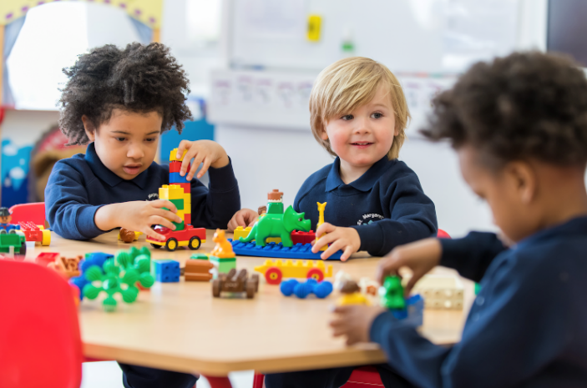
Transition event
School session and Lunch – Wednesday 5th July
Spend the morning in the setting with their new teacher and friends
Arrive at the office and hand in paperwork
Accompany children into the classroom at 9.15
Stay for school lunch
Collect from the office at 11.55am (Full time Christ Church nursery will be accompanied back to their classroom. Afternoon nursery to attend at 12.15 as usual.
Please order you child’s lunch with Miss Douglas before you leave and let us know of any allergies. This will cost £2.85 and you can choose between fish fingers and chips or Quorn nuggets and chips.

Slide 11
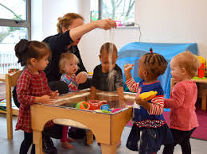
Transition event
Nursery Visits
Visits to nurseries have been arranged over the next few weeks
We will observe your child in their current setting and talk to staff in order to gather as much information about them as we can
Home visits have been arranged for those children not currently attending a nursery
Aim is to make the transition from home or nursery as smooth as it can be so our pupils are happy and settled into their new school environment

Slide 12
September
Your child will start school full time on Wednesday September 6th 2023.

Slide 13
Visit the classrooms
Thank you for your time
These slides are available on the website
Please collect your child and come and visit the classrooms and meet our teaching staff/SENDco.
Opportunity to ask any questions you may have

